Slide 1
CSC2535: 2013
Advanced Machine Learning Lecture 8b
Image retrieval using multilayer neural networks
Geoffrey Hinton

Slide 2
Overview
An efficient way to train a multilayer neural network to extract a low-dimensional representation.
Document retrieval (published work with Russ Salakhutdinov)
  How to model a bag of words with an RBM
  How to learn binary codes
  Semantic hashing: retrieval in no time
Image retrieval (published work with Alex Krizhevsky)
  How good are 256-bit codes for retrieval of small color images?
  Ways to use the speed of semantic hashing for much higher-quality image retrieval (work in progress).

Slide 3
Deep Autoencoders
(with Ruslan Salakhutdinov)
28x28
1000 neurons
They always looked like a really nice way to do non-linear dimensionality reduction:
  But it is very difficult to optimize deep autoencoders using backpropagation.
We now have a much better way to optimize them:
  First train a stack of 4 RBM’s
  Then “unroll” them.
  Then fine-tune with backprop.
500 neurons
250 neurons
30
250 neurons
500 neurons
1000 neurons
28x28

Slide 4
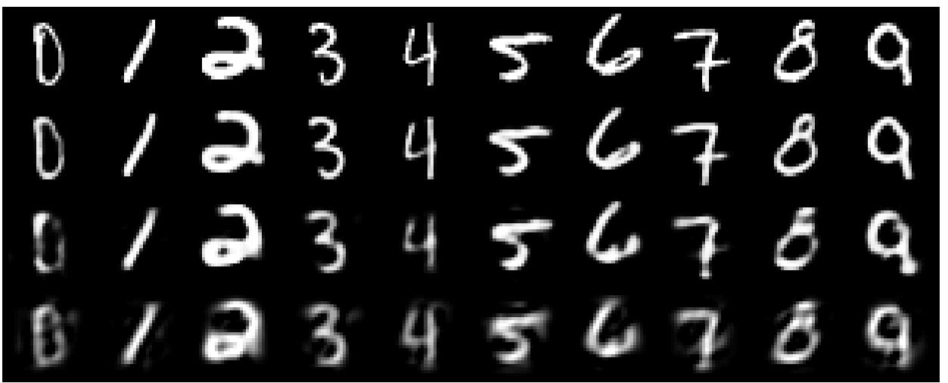
A comparison of methods for compressing digit images to 30 real numbers.
real data
30-D deep auto
30-D logistic PCA
30-D PCA

Slide 5
Compressing a document count vector to 2 numbers
output vector
2000 reconstructed counts
500 neurons
We train the autoencoder to reproduce its input vector as its output
This forces it to compress as much information as possible into the 2 real numbers in the central bottleneck.
These 2 numbers are then a good way to visualize documents.
250 neurons
2
real-valued units
250 neurons
500 neurons
We need a special type of RBM to model counts
2000 word counts

Slide 6
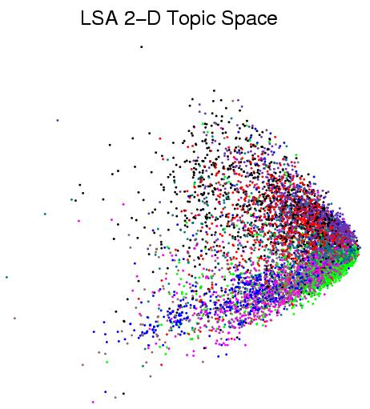
First compress all documents to 2 numbers using a type of PCA Then use different colors for different document categories
Yuk!

Slide 7
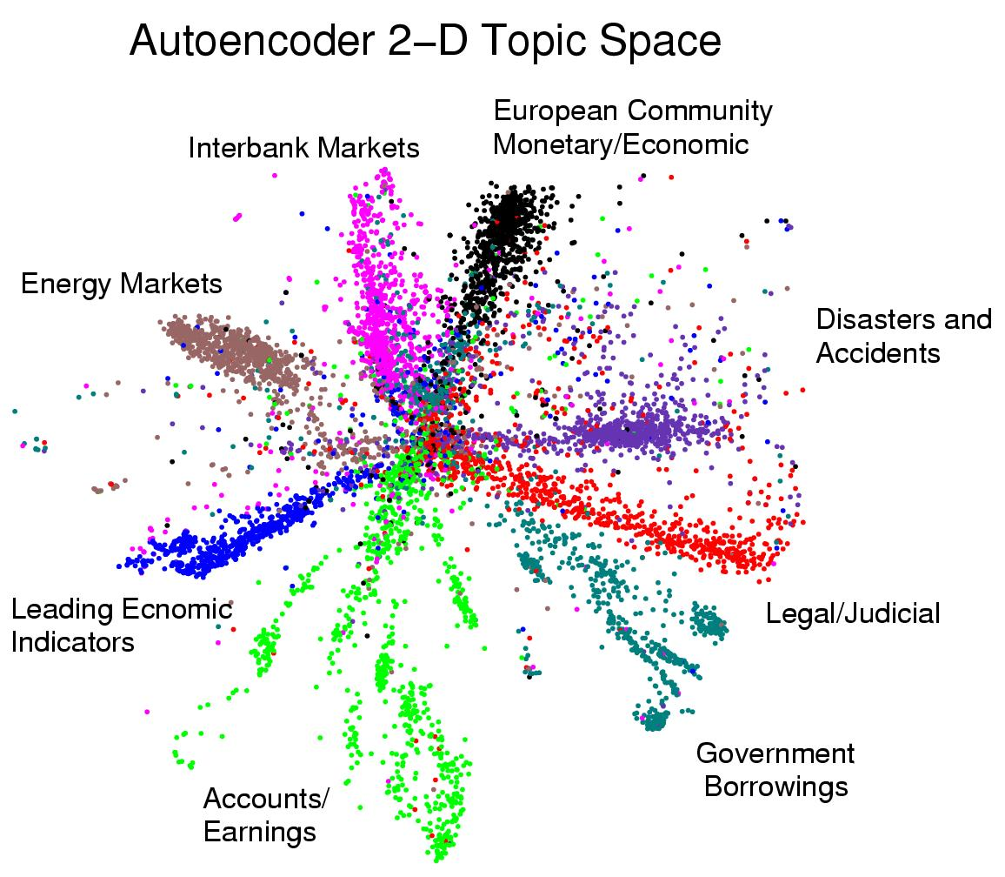
First compress all documents to 2 numbers. Then use different colors for different document categories

Slide 8
The replicated softmax model: How to modify an RBM to model word count vectors
Modification 1: Keep the binary hidden units but use “softmax” visible units that represent 1-of-N
Modification 2: Make each hidden unit use the same weights for all the visible softmax units.
Modification 3: Use as many softmax visible units as there are non-stop words in the document.
  So its actually a family of different-sized RBMs that share weights. Its not a single generative model.
Modification 4: Multiply each hidden bias by the number of words in the document (not done in our earlier work)
The replicated softmax model is much better at modeling bags of words than LDA topic models (in NIPS 2009)

Slide 9
The replicated softmax model
All the models in this family have 5 hidden units. This model is for 8-word documents.

Slide 10
Finding real-valued codes for retrieval
2000 reconstructed counts
Train an auto-encoder using 10 real-valued units in the code layer.
Compare with Latent Semantic Analysis that uses PCA on the transformed count vector
Non-linear codes are much better.
500 neurons
250 neurons
10
250 neurons
500 neurons
2000 word counts

Slide 11
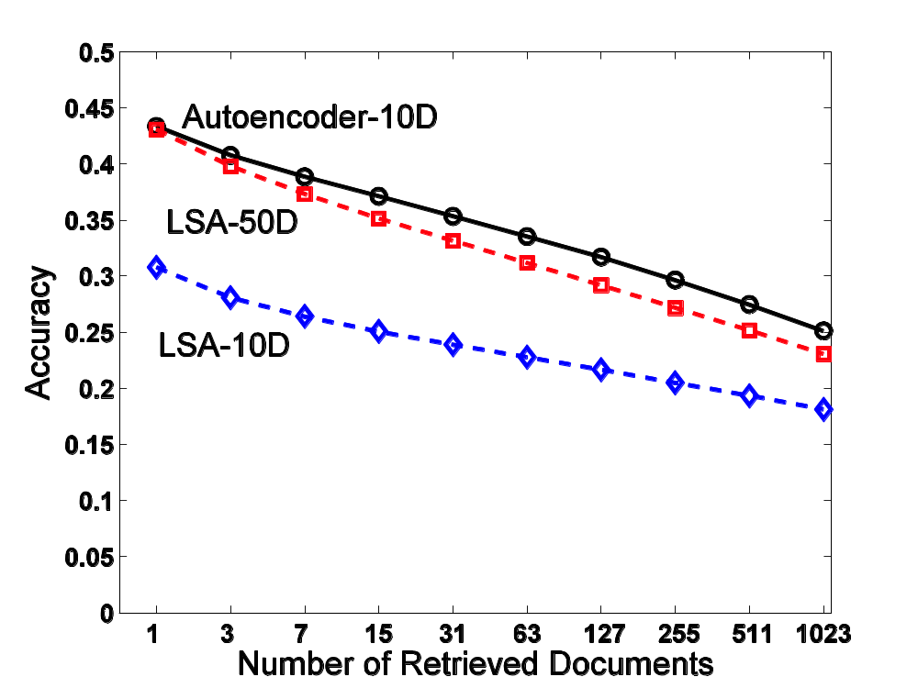
Retrieval performance on 400,000 Reuters business news stories

Slide 12
Finding binary codes for documents
2000 reconstructed counts
Train an auto-encoder using 30 logistic units for the code layer.
During the fine-tuning stage, add noise to the inputs to the code units.
  The “noise” vector for each training case is fixed. So we still get a deterministic gradient.
  The noise forces their activities to become bimodal in order to resist the effects of the noise.
  Then we simply threshold the activities of the 30 code units to get a binary code.
500 neurons
250 neurons
30
noise
250 neurons
500 neurons
2000 word counts

Slide 13
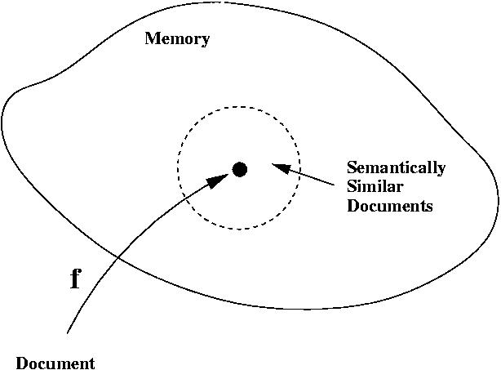
Using a deep autoencoder as a hash-function for finding approximate matches
hash function
“supermarket search”

Slide 14
Another view of semantic hashing
Fast retrieval methods typically work by intersecting stored lists that are associated with cues extracted from the query.
Computers have special hardware that can intersect 32 very long lists in one instruction.
  Each bit in a 32-bit binary code specifies a list of half the addresses in the memory.
Semantic hashing uses machine learning to map the retrieval problem onto the type of list intersection the computer is good at.

Slide 15
How good is a shortlist found this way?
Russ has only implemented it for a million documents with 20-bit codes --- but what could possibly go wrong?
  A 20-D hypercube allows us to capture enough of the similarity structure of our document set.
The shortlist found using binary codes actually improves the precision-recall curves of TF-IDF.
  Locality sensitive hashing (the fastest other method) is much slower and has worse precision-recall curves.

Slide 16
Semantic hashing for image retrieval
Currently, image retrieval is typically done by using the captions. Why not use the images too?
  Pixels are not like words: individual pixels do not tell us much about the content.
  Extracting object classes from images is hard.
Maybe we should extract a real-valued vector that has information about the content?
  Matching real-valued vectors in a big database is slow and requires a lot of storage
Short binary codes are easy to store and match

Slide 17
A two-stage method
First, use semantic hashing with 30-bit binary codes to get a long “shortlist” of promising images.
Then use 256-bit binary codes to do a serial search for good matches.
  This only requires a few words of storage per image and the serial search can be done using fast bit-operations.
But how good are the 256-bit binary codes?
  Do they find images that we think are similar?

Slide 18
Some depressing competition
Inspired by the speed of semantic hashing, Weiss, Fergus and Torralba (NIPS 2008) used a very fast spectral method to assign binary codes to images.
  This eliminates the long learning times required by deep autoencoders.
They claimed that their spectral method gave better retrieval results than training a deep auto-encoder using RBM’s.
  But they could not get RBM’s to work well for extracting features from RGB pixels so they started from 384 GIST features.
  This is too much dimensionality reduction too soon.

Slide 19
A comparison of deep auto-encoders and the spectral method using 256-bit codes
(Alex Krizhevsky)
Train auto-encoders “properly”
  Use Gaussian visible units with fixed variance. Do not add noise to the reconstructions.
  Use a cluster machine or a big GPU board.
  Use a lot of hidden units in the early layers.
Then compare with the spectral method
  The spectral method has no free parameters.
Also compare with Euclidean match in pixel space

Slide 20
Krizhevsky’s deep autoencoder
The encoder has about 67,000,000 parameters.
It takes a few GTX 285 GPU days to train on two million images.
256-bit binary code
512
There is no theory to justify this architecture
1024
2048
4096
8192
1024
1024
1024

Slide 21
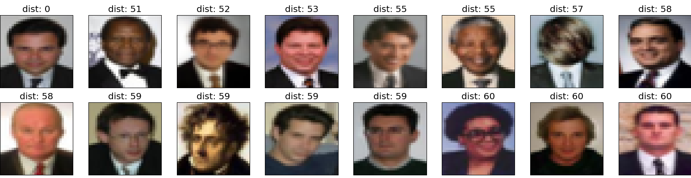
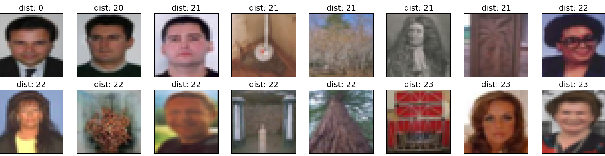
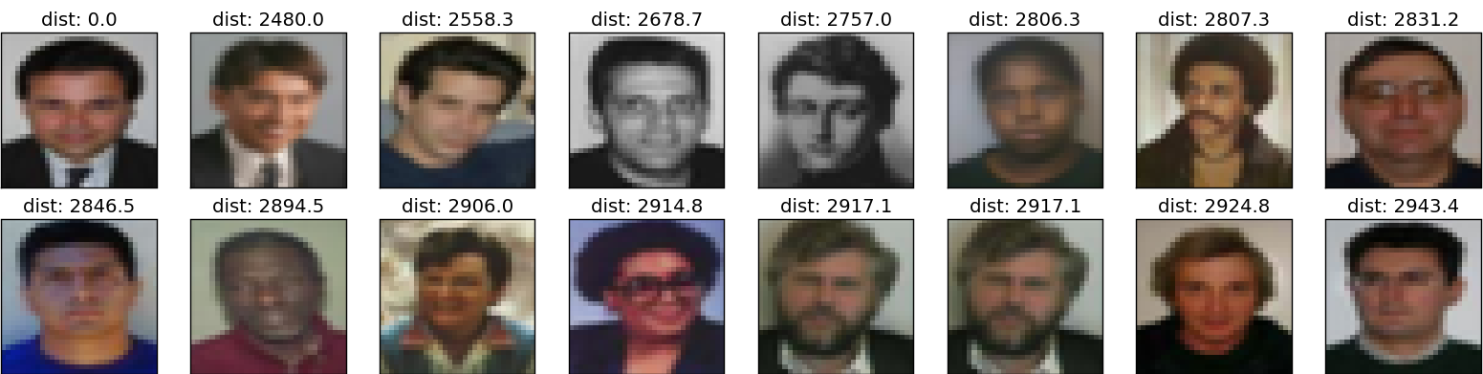
A
S
E

Slide 22
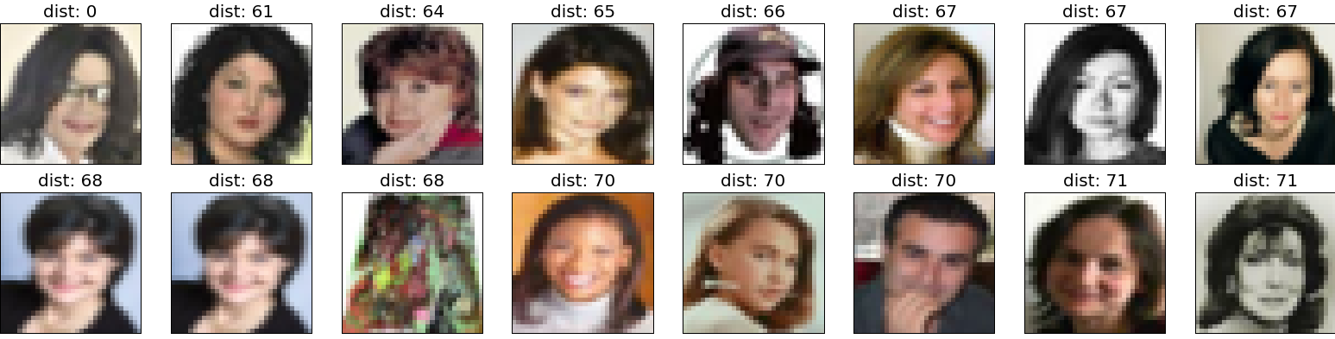
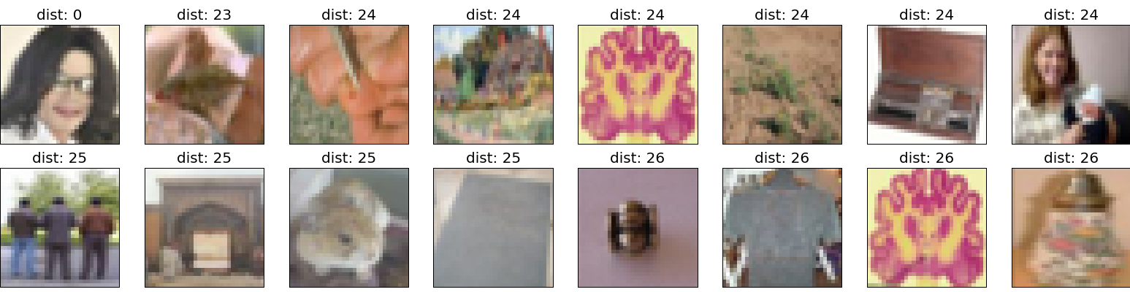
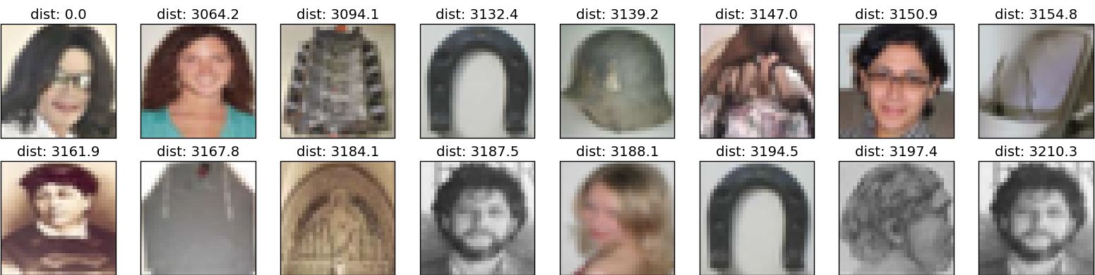
A
S
E

Slide 23
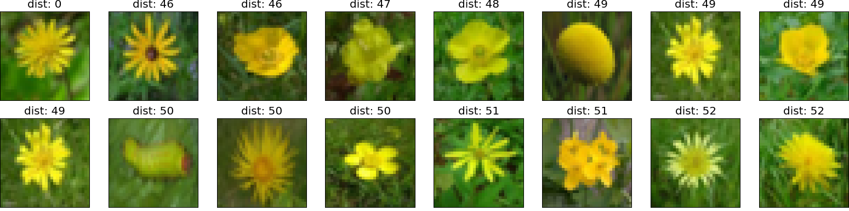
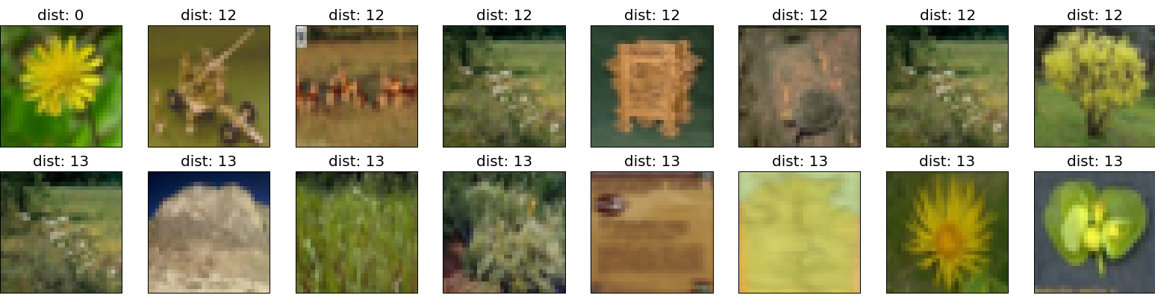
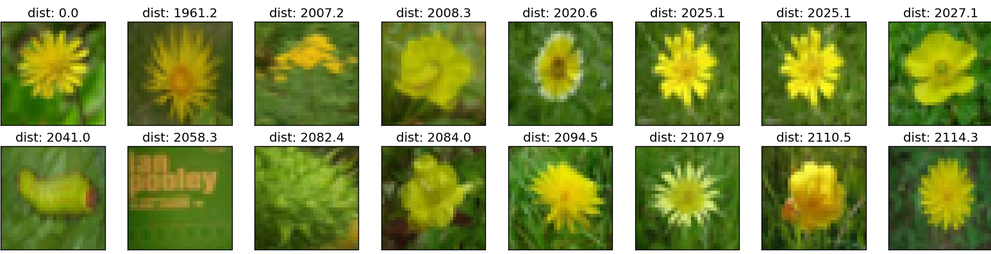
A
S
E

Slide 24
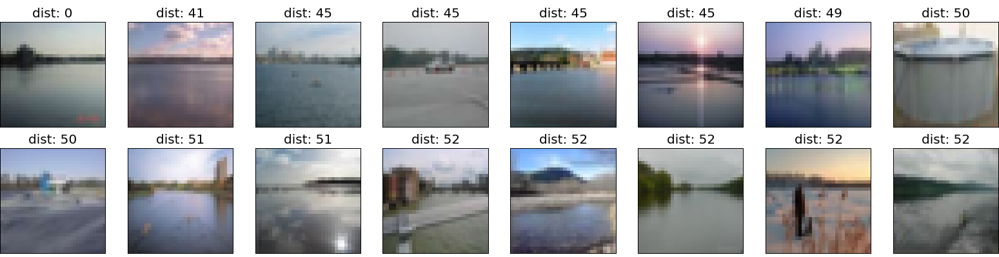
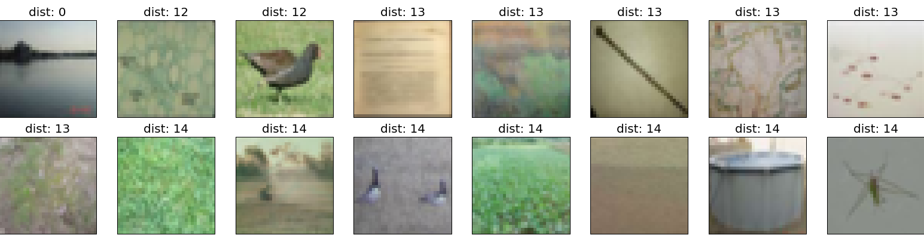
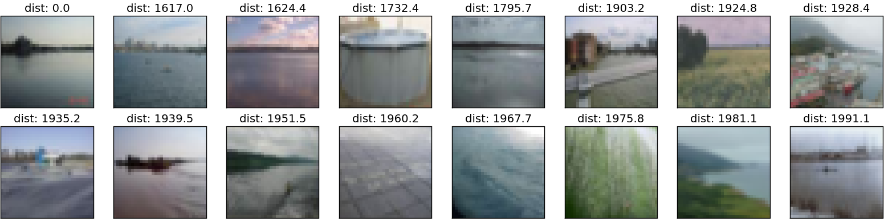
A
S
E

Slide 25
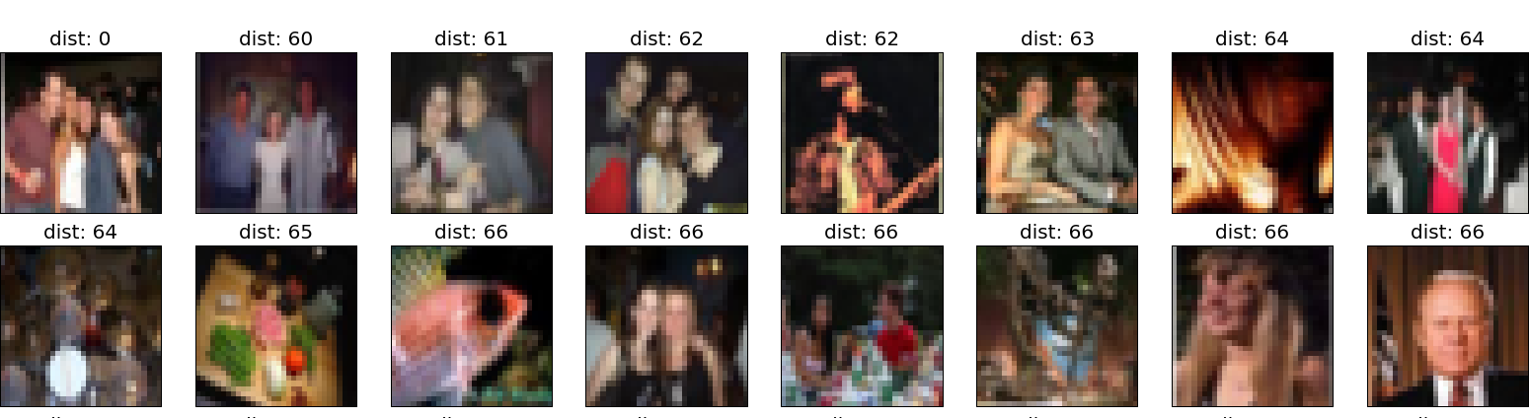
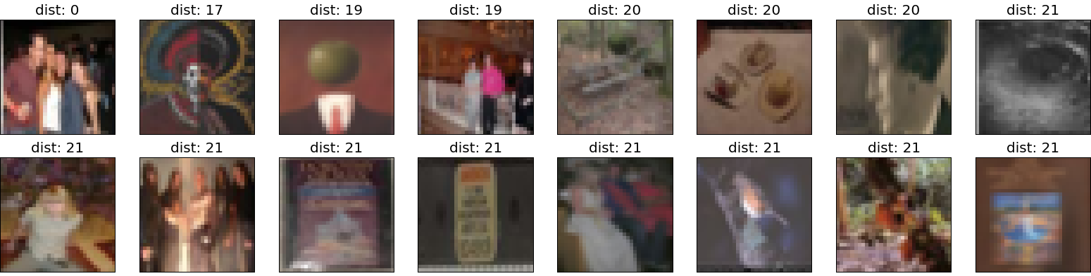
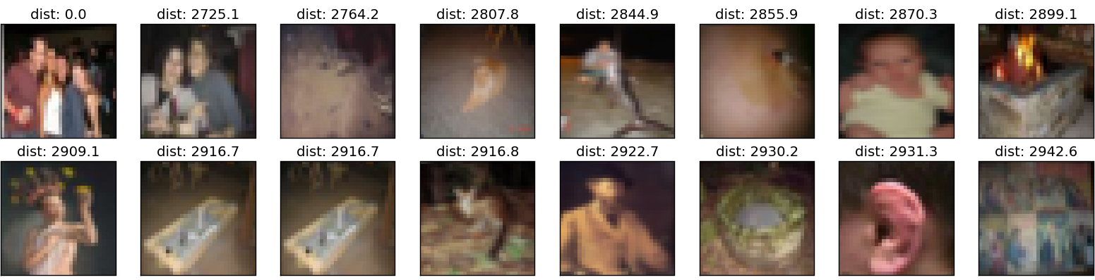
A
S
E

Slide 26
The next step
Implement the semantic hashing stage for images.
Check that a long shortlist still contains many good matches.
  It works OK for documents, but they are very different from images.
  Losing some recall may be OK. People don’t miss what they don’t know about.

Slide 27
An obvious extension
Use a multimedia auto-encoder that represents captions and images in a single code.
  The captions should help it extract more meaningful image features such as “contains an animal” or “indoor image”
RBM’s already work much better than standard LDA topic models for modeling bags of words.
  So the multimedia auto-encoder should be + a win (for images) + a win (for captions) + a win (for the interaction during training)

Slide 28
A less obvious extension
Semantic hashing gives incredibly fast retrieval but its hard to go much beyond 32 bits.
We can afford to use semantic hashing several times with variations of the query and merge the shortlists
  Its easy to enumerate the hamming ball around a query image address in ascending address order, so merging is linear time.
Apply many transformations to the query image to get transformation independent retrieval.
  Image translations are an obvious candidate.

Slide 29
Summary
Restricted Boltzmann Machines provide an efficient way to learn a layer of features without any supervision.
  Many layers of representation can be learned by treating the hidden states of one RBM as the data for the next.
This allows us to learn very deep nets that extract short binary codes for unlabeled images or documents.
  Using 32-bit codes as addresses allows us to get approximate matches at the speed of hashing.
Semantic hashing is fast enough to allow many retrieval cycles for a single query image.
  So we can try multiple transformations of the query.

Slide 30
A more interesting extension
Computer vision uses images of uniform resolution.
  Multi-resolution images still keep all the high-resolution pixels.
Even on 32x32 images, people use a lot of eye movements to attend to different parts of the image.
  Human vision copes with big translations by moving the fixation point.
  It only samples a tiny fraction of the image at high resolution. The “post-retinal’’ image has resolution that falls off rapidly outside the fovea.
  With less “neurons” intelligent sampling becomes even more important.

Slide 31
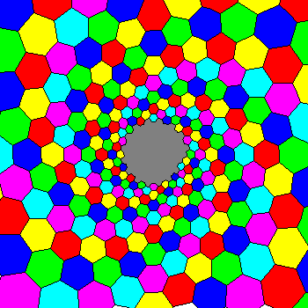
How to perceive a big picture with a small brain
Even a human brain cannot afford high-resolution everywhere.
  By limiting the input we make it possible to use many layers of dense features intelligently.
For fine discrimination that requires high-resolution in several different places we must integrate over several fixations.
A much better “retina”.

Slide 32
A more human metric for image similarity
Two images are similar if fixating at point X in one image and point Y in the other image gives similar post-retinal images.
So use semantic hashing on post-retinal images.
  The address space is used for post-retinal images and each address points to the whole image that the post-retinal image came from.
  So we can accumulate similarity over multiple fixations.
The whole image addresses found after each fixation have to be sorted to allow merging ☹

Slide 33
Starting from a better input representation
First learn a good model for object recognition that can deal wit multiple objects in the same image.
Then use the outputs of the last hidden layer as the inputs to a deep autoencoder.
This should work really well.
  Euclidean distance on the activities n the last hidden layer already works extremely well.

Slide 34
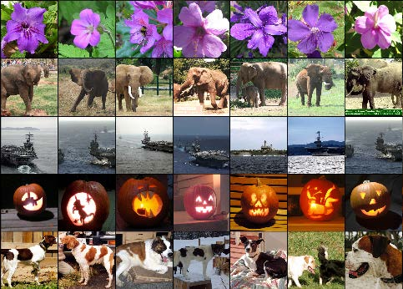
cue
Euclidean nearest neighbors using the 4096 activities in the last hidden layer

